Slide 1
Data Science Case Studies!

Slide 2


Data Science and the NBA
Data Science and Success in Sports
Basketball analytics investment is key to NBA wins and other successes | MIT News
UC Berkeley alum transforms NBA strategy with data science

Slide 3
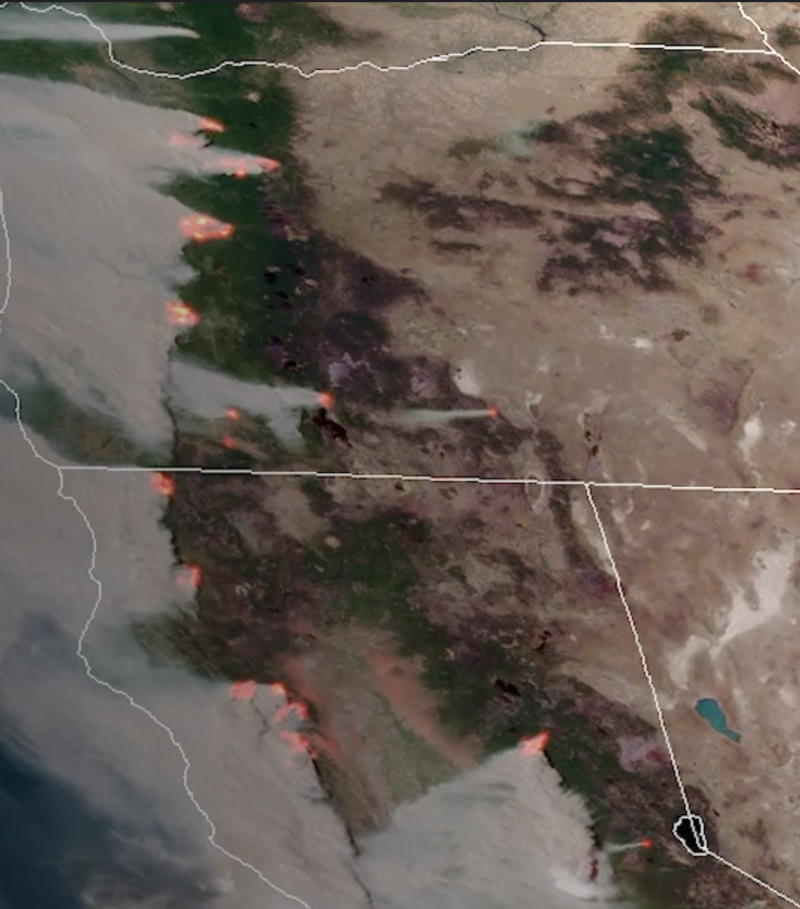
NASA and Climate Change Data
Environmental Science

Slide 4


Slide 5
How can data science be used to understand/address this problem?
https://science.nasa.gov/earth/explore/wildfires-and-climate-change/

Slide 6
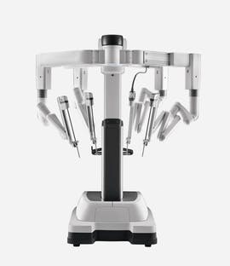
AI and Medicine
How AI can revolutionize the Medical Field
How Intuitive Surgical advances robotic-assisted surgery with machine learning
Read this article!

Slide 7

Can AI make surgery safer?

Slide 8
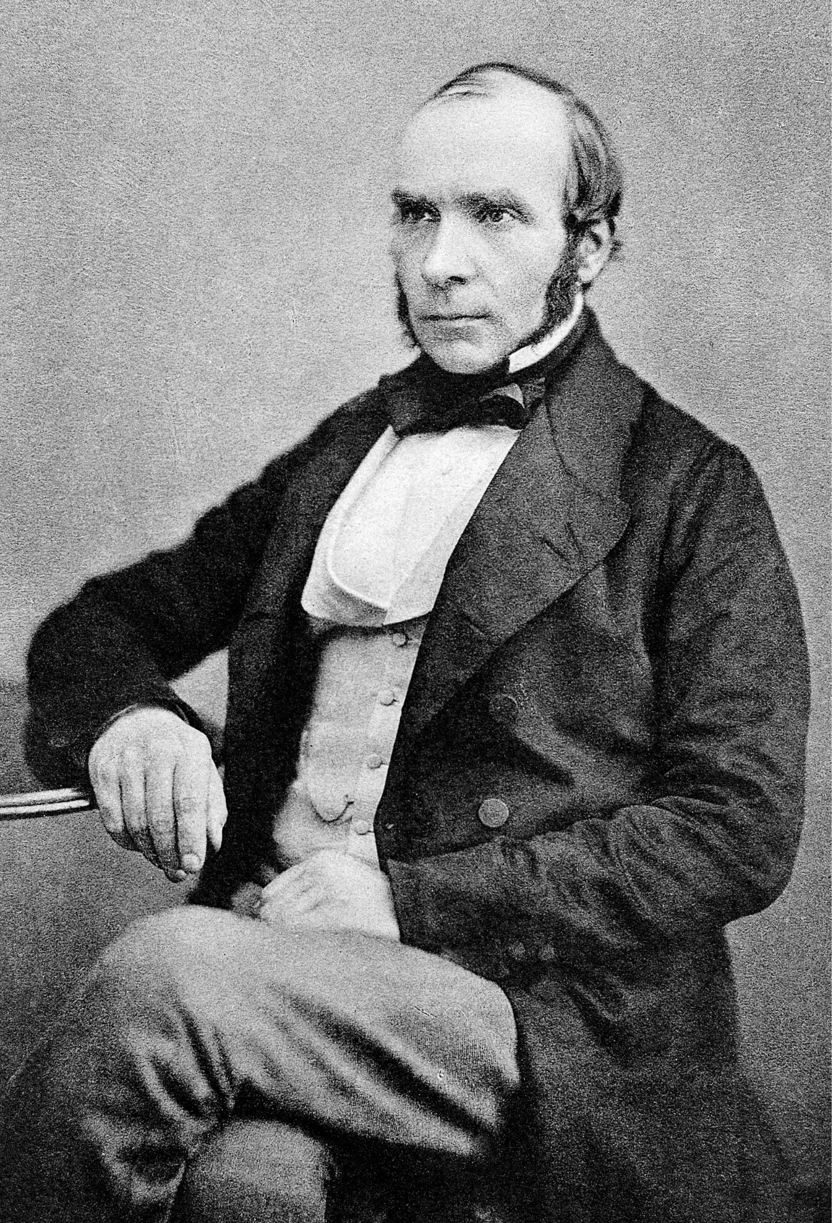
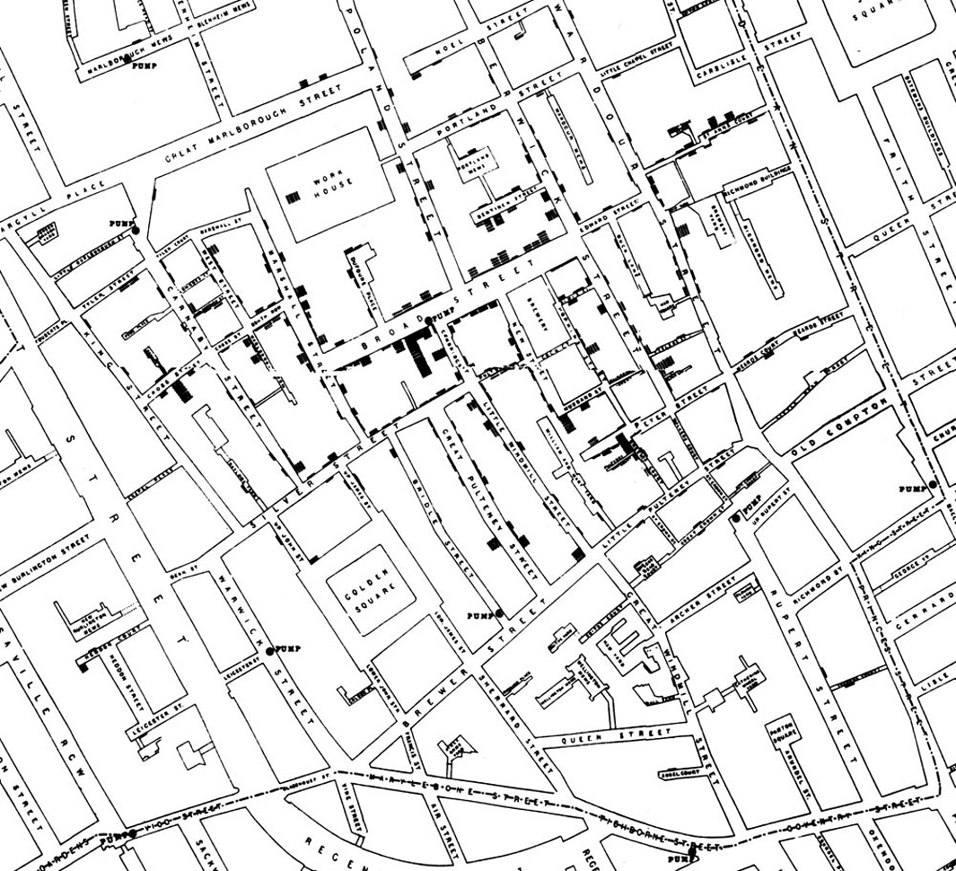
John Snow and the Broad Street Pump
Public Health
Notes:
Image credits
https://en.wikipedia.org/wiki/John_Snow
https://www.cs.cornell.edu/courses/cs1380/2018sp/textbook/chapters/02/1/observation-and-visualization-john-snow-and-the-broad-street-pump.html

Slide 9

More info: https://inferentialthinking.com/chapters/02/1/observation-and-visualization-john-snow-and-the-broad-street-pump.html

Slide 10

Data Science in the Real World
Choose your own adventure
Notes:
Image: https://pixabay.com/vectors/earth-world-planet-globe-global-3107835/

Slide 11
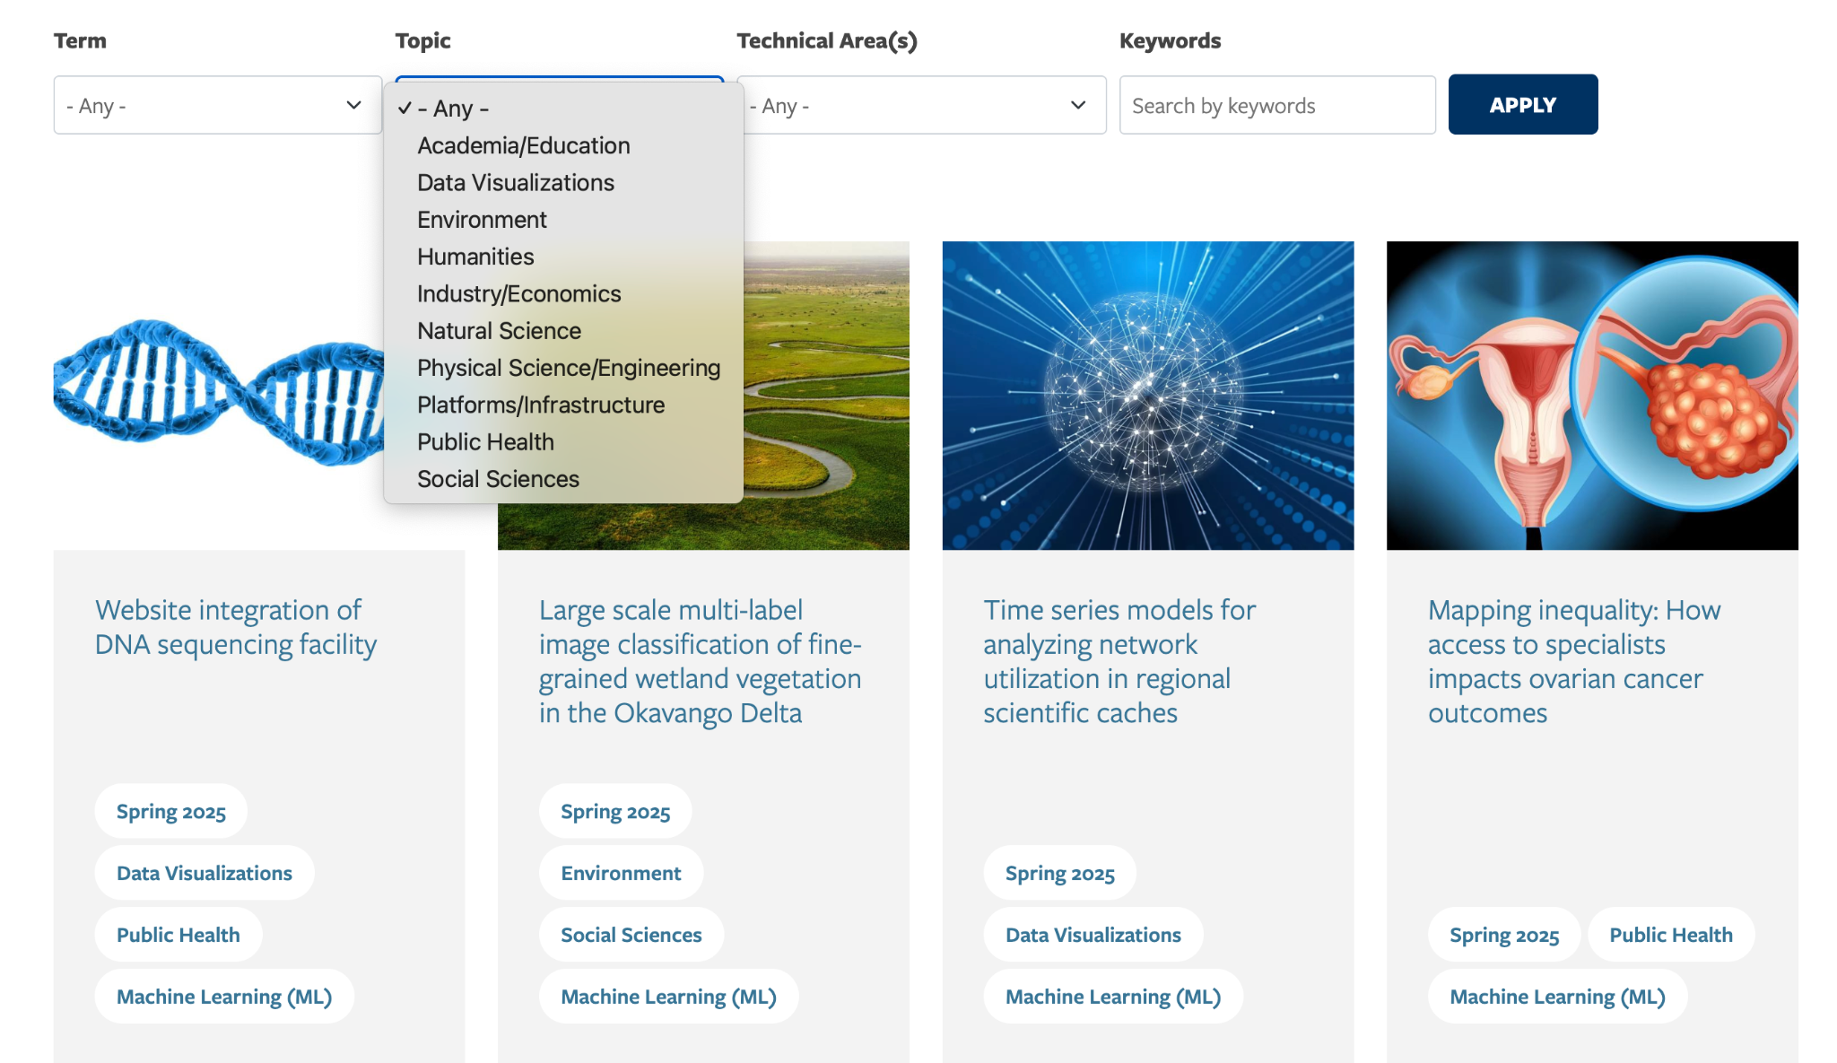
https://cdss.berkeley.edu/discovery/projects
Choose an interesting topic
Pick a project or two and read about it for 10-15 minutes
Summarize and discuss with your group

